Slide 1

ANDROID APP DEVELOPMENT
FOOD WASTE MANAGEMENT APP

Slide 2


TEAM MEMBERS
1.SANAL MISHRA
2.SARVENDRA KR.SINGH
3.UTKARSH AGRAWAL
4.PRABHAT KR.SINGH

Slide 3

WHAT IS THIS PROJECT?
Food wastage in nowadays became a serious problem and we should find a solution for this problem. As food wastage is directly related to the problem of hunger and malnutrition in children.
This food waste management app can be the end of all this problem. As, this project will help in controlling the wastage of food in the area ,by linking those who are in shortage of food to those who have in access and are willing to donate food. This project will work as an NGO and will help in controlling shortages and in managing wastage of food.

Slide 4
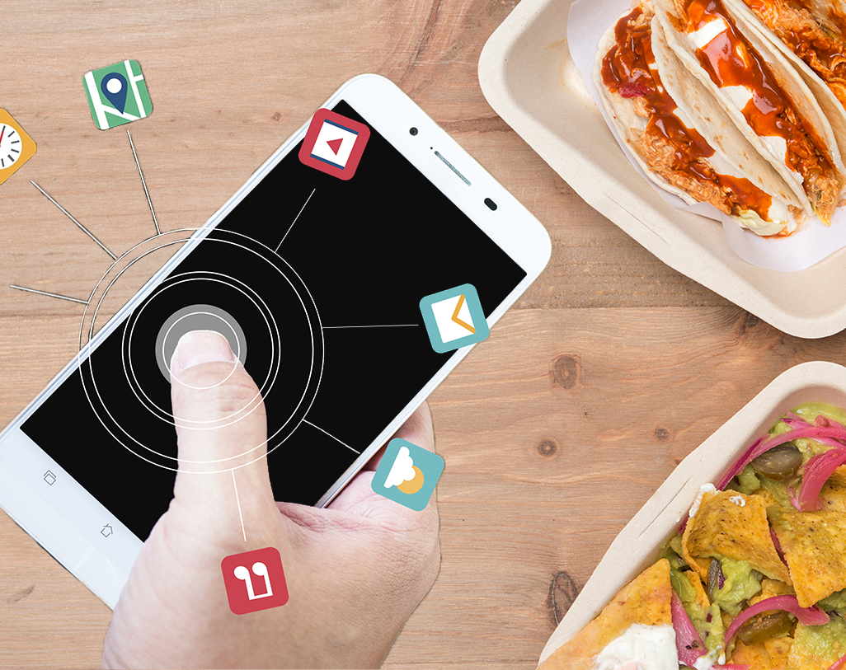
OVERVIEW OF PROJECT:
The main objective of this application is that to reduce the number of people dying due to starvation and malnutrition problems in children. This application will give people a better structure scope of how to store their extra food and how they can help some other people with their extra food by using just a small application.

Slide 5
Hardware And Software Requirements:
Hardware Requirements:
4GB or higher RAM
Minimum i5 Processor
A backup disk/drive.
Software Requirements:
Android Studio
Java IDE
SQL Editor
PHP Editor
Android Emulator

Slide 6
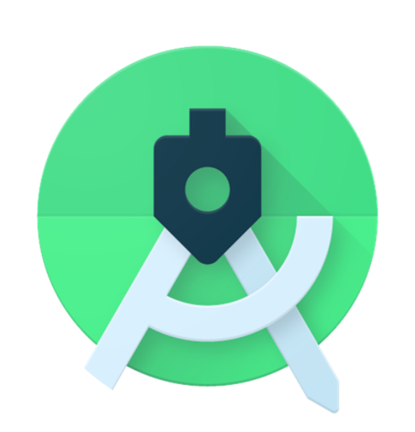
Android Studio:
Android Studio is the official Integrated Development Environment (IDE) for Android app development, based on IntelliJ IDEA . On top of IntelliJ's powerful code editor and developer tools, Android Studio offers even more features that enhance your productivity when building Android apps, such as:
1.A flexible Gradle-based build system
2.A fast and feature-rich emulator
3.A unified environment where you can develop for all Android devices

Slide 7
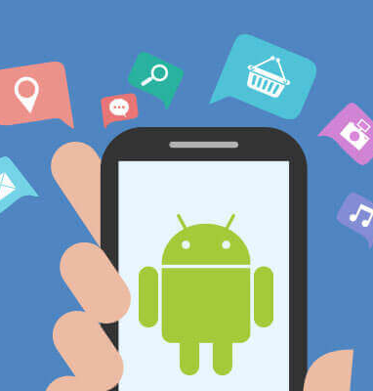
Structure Of An Android Application
An android application can be formed using two files namely .xml file which is used for providing the structure to our app and the .java file which is used to add the functionalities to our application.

Slide 8
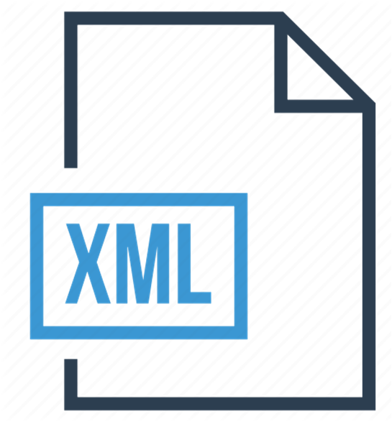
A basic introduction to XML and markup languages
XML stands for Extensible Markup Language, which gives us a clue to what it does. A markup language is slightly different from a programming language. Whereas a programming language (C#, C++, Java, Kotlin, Python, BASIC) will allow you to define behaviors, interactions, and conditions; a markup language is used more to describe data, and in this case, layouts. Programming languages create dynamic interactions, whereas markup languages generally handle things like static user interfaces.

Slide 9
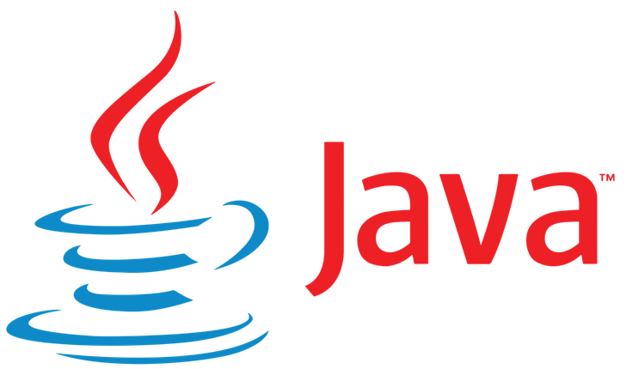
Introduction To Java
When it’s time to develop Android apps, Jave remains one of the two official options. This means that it has a lot of support from Google. Most non-game apps were probably built with either Java or Kotlin. The number one way to develop Android apps, is to go ahead and download Android Studio. This is a piece of software called an IDE, or Integrated Development Environment. It will come packaged with the Android SDK (a set of tools to facilitate Android development specifically) and this will give you everything you need in one place to get up and running.

Slide 10
Kotlin vs Java for Android
KOTLIN is a cross platform, statically types, general purpose programming language with type inference. KOTLIN is designed to interoperate fully with java but type inference allows its syntax to be more concise.KOTLIN is sponsored by JetBrains and Google through the Kotlin Foundation.
JAVA is an Object Oriented Programming Language developed by JAMES GOSLING and colleagues at SUN MICRO SYSTEMS in 1991.The language was initially called OAK. It was developed as a full fledged programming language in which one can accomplish the same sorts of tasks and solve the similar problems that one can do in other programming languages such as BASIC,C++ etc. Despite all the differences between the two languages, Java and Kotlin are 100% interoperable. You can call Kotlin code from Java, and you can call Java code from Kotlin. So it’s possible to have Kotlin and Java classes side-by-side within the same project, and everything will still compile.

Slide 11

Fire Base
Firebase is Google's mobile platform that helps you quickly develop highquality apps and grow your business. Firebase gives you functionality like analytics, databases, messaging and crash reporting so you can move quickly and focus on your users. It builds app fast without managing infrastructure. Firebase is built on Google infrastructure and scales automatically, for even the largest apps.Firebase products work great individually but share data and insights, so they work even better together. Firebase improves app quality. It gives crashlytics , performance monitoring , test lab, app distribution , Authentication, cloud functions, hosting, cloud storage,google analytics ,remote configuration, realtime database and so on.

Slide 12
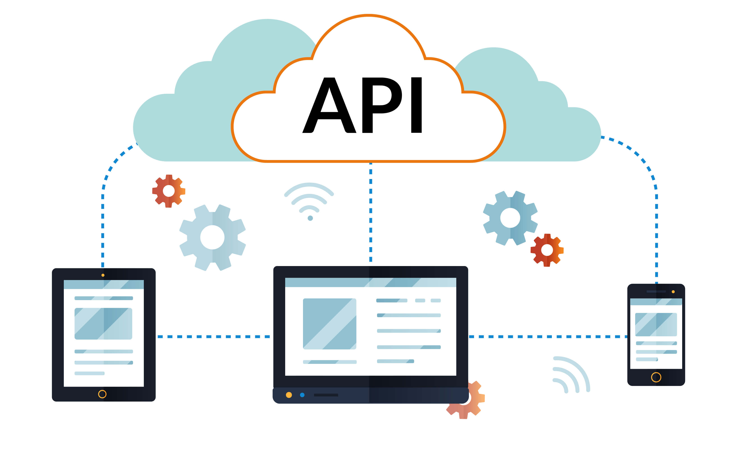
APIs
API stands for application programming interface, a concept that applies everywhere from command-line tools to enterprise Java code to Ruby on Rails web apps. An API is a way to programmatically interact with a separate software component or resource.

Slide 13
APIs Used In Our Project
The API used are : Google Maps
Maps SDK Android
Google Maps is a web mapping service developed by Google. It offers satellite imagery, aerial photography, street maps, 360° interactive panoramic views of streets (Street View), realtime traffic conditions, and route planning for traveling by foot, car, bicycle and air (in beta), or public transportation. Google Maps' satellite view is a "up- down" or bird's-eye view; most of the high-resolution imagery of cities is aerial photography . Google Maps used a variant of the Mercator projection, and therefore could not accurately show areas around the poles.

Slide 14
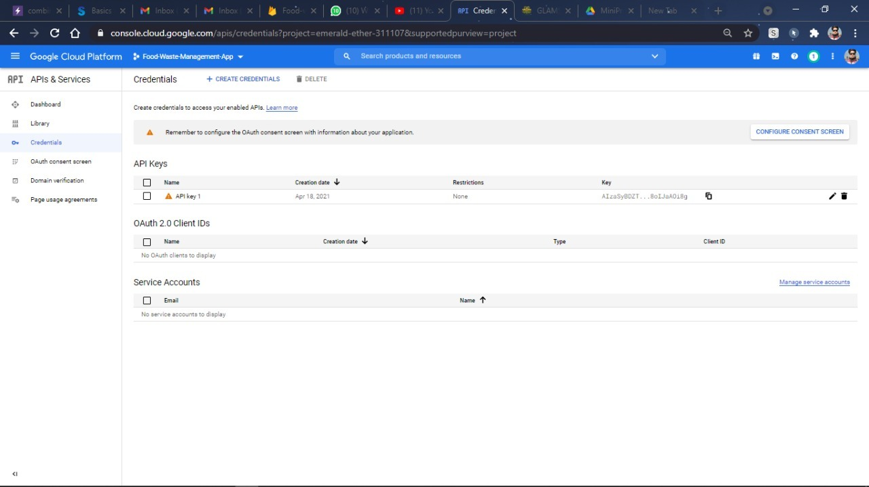
GOOGLE CLOUD PROJECT
Google Cloud projects form the basis for creating, enabling, and using all Google Cloud services including managing APIs, enabling billing, adding and removing collaborators, and managing permissions for Google Cloud resources.
Cloud computing today allows hardware and software products to co-exist remotely (in data centers) and at-scale. Together these products work to deliver specific services. Users typically can access, manage, and use the tools they require via a web-interface – and that's true for Google Cloud Platform services as well.

Slide 15
MODULES AND FUCTIONALITIES
1.Main Activity
2. Login Activity
NGO LOGIN ACTIVITY
CUSTOMER/DONOR LOGIN ACTIVITY
3. Map Activity
NGO MAP ACTIVITY
CUSTOMER/DONOR MAP ACTIVITY
4.Profile Activity
CUSTOMER PROFILE ACTIVITY
NGO PROFILE ACTIVITY
5.OnAppkilled Activity

Slide 16
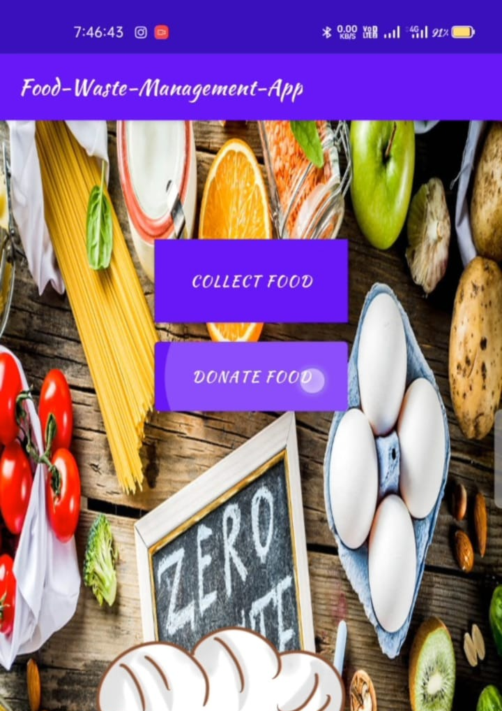
MAIN ACTIVITY
It is the main module of our application as it is giving a direct link between the NGO and the Customers. The main activity of our application is the donation of food by the customers and picking of food by the NGO driver is under this module only.
This particular module consists of two different modules NGO and customer there will be two buttons one of NGO and one of the customer once you click any of them it will ask for login for the selected one so it also merged with NGO login and the customer login modules.

Slide 17


Login Activity
We have module division starting from this activity. The activity shows similar kind of interface in both the modules but are seperately authorised for authentication from firebase.
We have build same activity for both the modules with different IDs and Authentication, which takes them to next activity with features depending on the requirement of respective modules.
This activity consists of two different login activity.

Slide 18
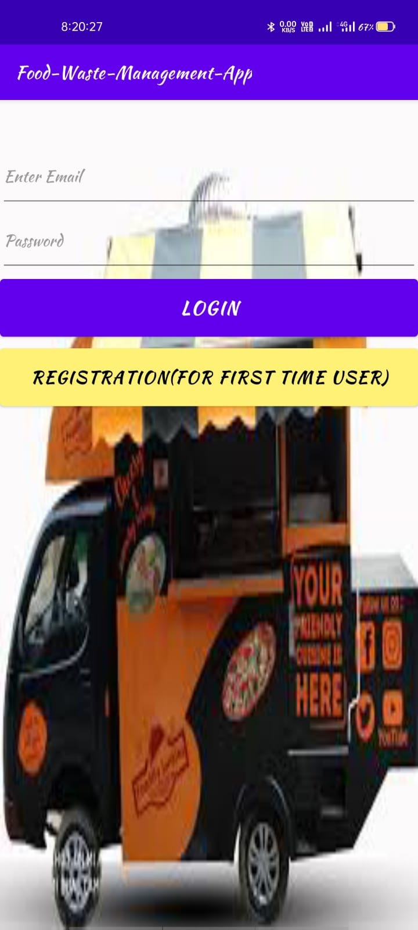
NGO LOGIN ACTIVITY
This particular activity is for the login of the NGO. In this module, the NGO will give his email id and password there will be a login button as the details given by the NGO that is email id and password matched by those in our database it will show message login successful otherwise it will show an error once the login is successful the NGO will be registered. This module merges with the NGO map activity.

Slide 19
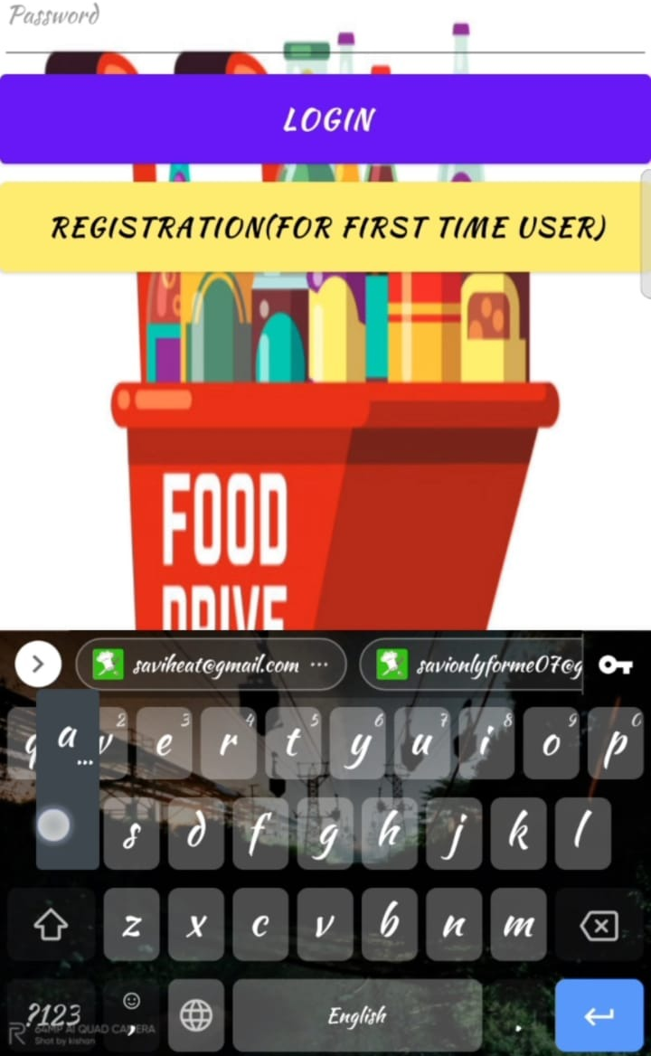
CUSTOMER/DONOR LOGIN ACTIVITY
This particular activity is for the login of the Customer. In this module, the Customer will give his email id and password there will be a login button as the details given by the Customer that is email id and password matched by those in our database it will show message login successful otherwise it will show an error once the login is successful the Customer will be registered. This module merges with the Customer map activity.

Slide 20

Map Activity
This activity takes us to a page where we can check our location and further access other all other activities/functions. This activity can only be accessed if our Firebase Client permits us for authentication. This activity is most important in our app and it links to Real-Time Database of our Firebase Project.

Slide 21
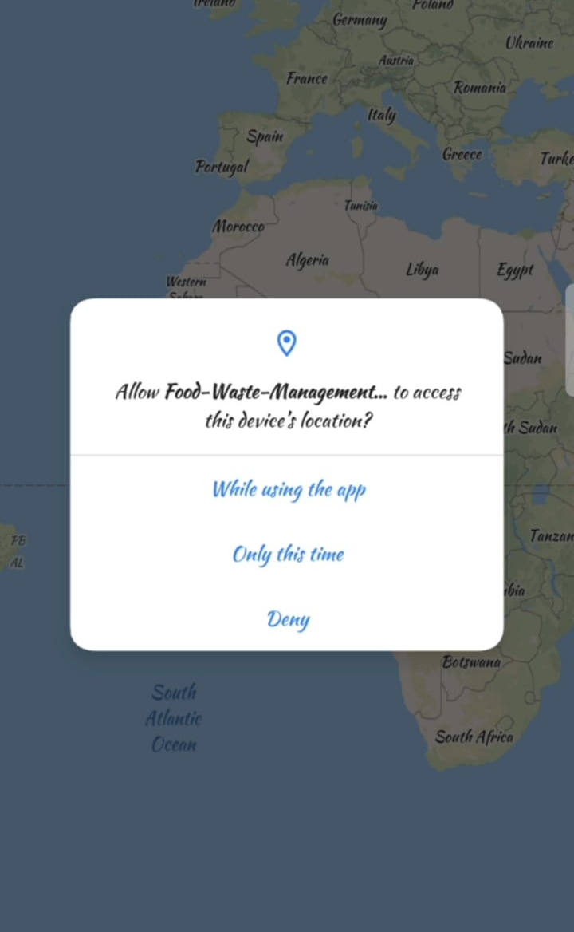
CUSTOMER MAP ACTIVITY
This activity takes us to the page where the customer can check his location. This activity can only be accessed if our Firebase Client permits us for authentication.IN these modules the customer can found the nearby NGO for the donation of food. A particular module merges with two other modules customer profile and our main activity. This activity is most important in our app and it links to the Real-Time Database of our Firebase Project.

Slide 22
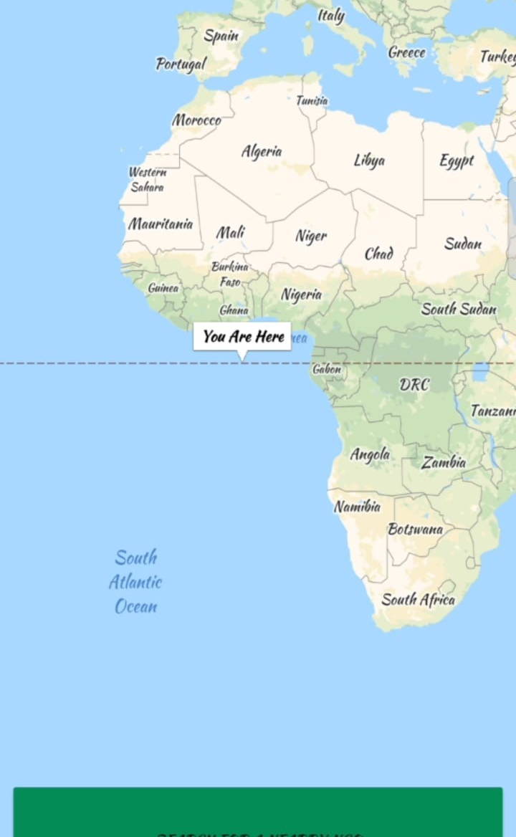
NGO MAP ACTIVITY(FOR NGO
This activity takes us to the page where we can check the location of the NGO. Nearby, NGOs which are ready to take the food from the customer or NGOs which are tied up with the application.AS customer adds a title (food is available) and goes to this particular activity it will show the location of the NGO. This activity is most important in our app and it links to the Real-Time Database of our Firebase Project.

Slide 23
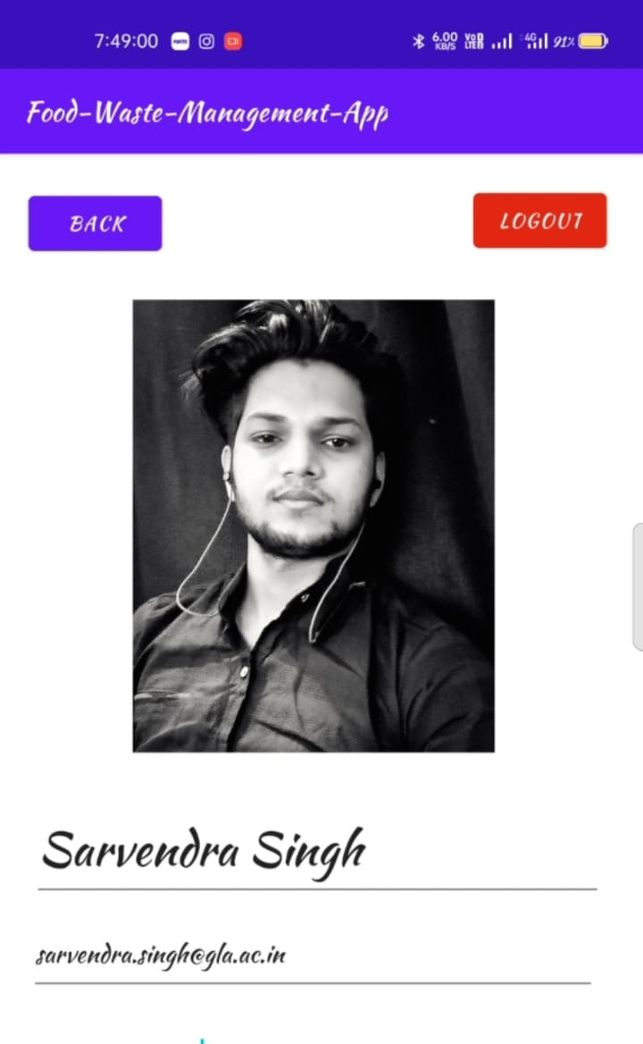
CUSTOMER PROFILE ACTIVITY
This activity tells us about the customer which is willing to donate the food identity this module contains all the fields of customer identity that like name, email, address, and profile photo. This module link(merge) with customer login module in this module the customer can view his or her profile and also update his or her profile when there is a change in any of the customer's fields. The module contains a database of customers.

Slide 24
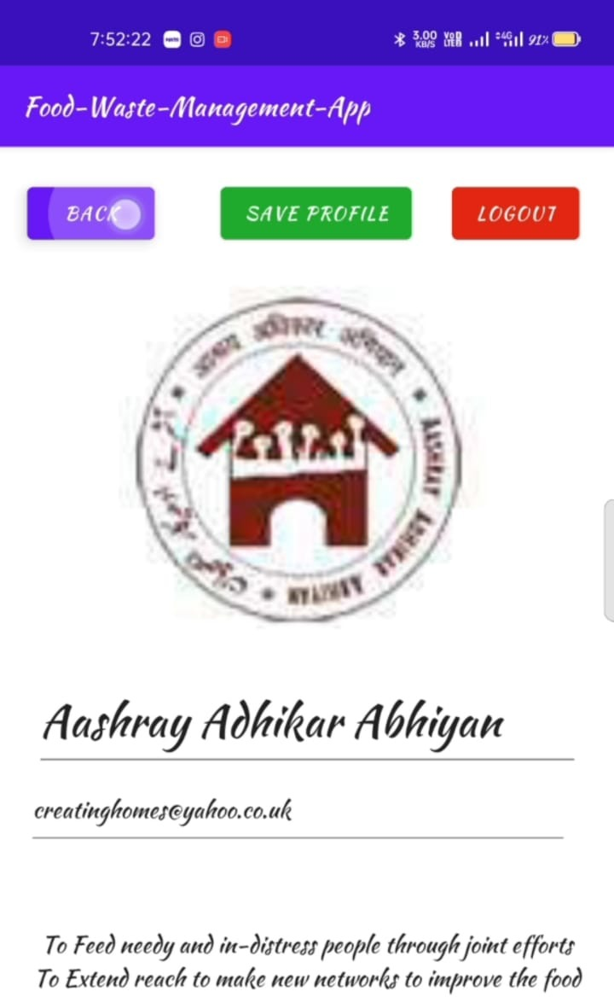
NGO ROFILE ACTIVITY
This activity tells us about the driver profile from our database which will be carrying the food from the customer from NGO. This module contains all the fields of driver identity that like name, email, address, about, and profile photo. This module is likely a customer profile it merges with driver login here driver can view his profile and can also update his profile when there is a change in any of the given fields. This module contains a database of drivers.

Slide 25
OnAppkilled Activity
This activity comes into effect the moment we are authorised for any one module of our app.
The activity prevents our data from being lost when the app is killed/crashed.
When the App crashes then it redirects the customer to the login page or in the main activity page .
The most important reason [apps crash] is the responsiveness and your app hanging when you're trying to get some data, or you have submitted something and you're waiting for a response.

Slide 26
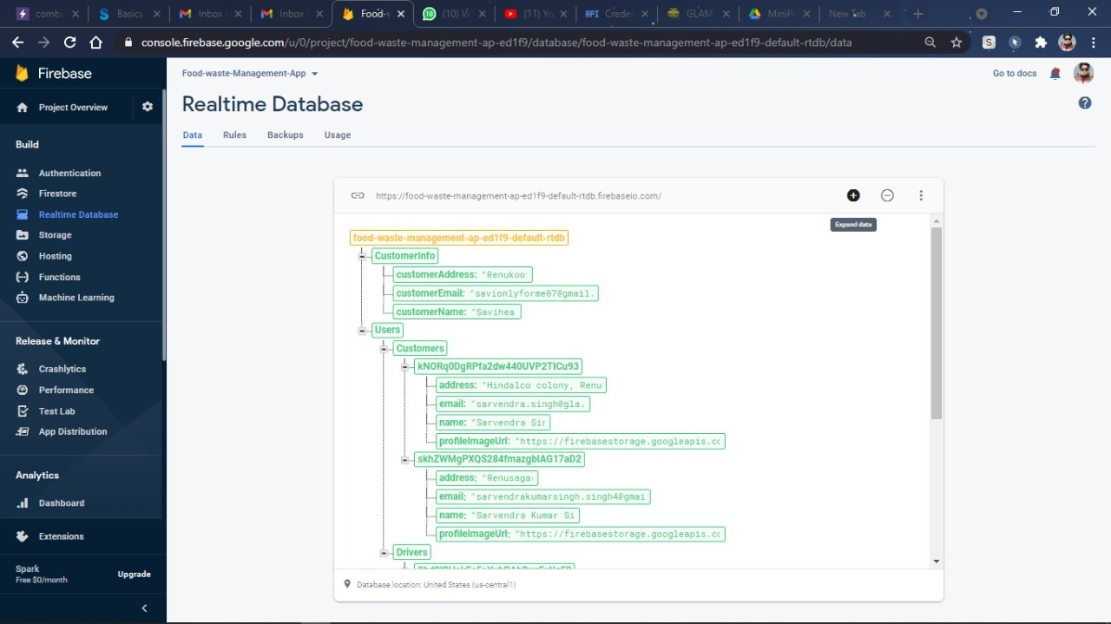
FIREBASE PROJECT
Firebase Authentication provides backend services, easy-to-use SDKs, and ready-made UI libraries to authenticate users to your app. It supports authentication using passwords,phone numbers, popular federated identity providers like Google, Facebook and Twitter, and more.Firebase Authentication integrates tightly with other Firebase services, and it leverages industry standards like OAuth 2.0 and OpenID Connect, so it can be easily integrated with your custom backend.

Slide 27
References
Realtime tracking management system using GPS,GPRS.
We preferred https://developers.google.com/maps/documentation/ios-sdk for Google Map APIs.
https://developers.google.com/places for selection of particular place.
www.google.com
developer.android.com
Firebase.google.com
codelabs.developers.google.com
Rob Percival, Nick Walter, Codestars by Rob Percival on Udemy.

Slide 28


